Slide 1
Secure Data hiding in images in steganography
Presented By:
Student Name : Rahul Raj
College Name & Department : Graphic Era University, IT

Slide 2
OUTLINE
Problem Statement
Technology used
Wow factor
End users
Result
Conclusion
Git-hub Link
Future scope

Slide 3
Problem Statement
In today’s digital world, securing sensitive information during transmission is critical.
Traditional encryption methods make data unreadable, but they also draw attention.
Steganography provides a solution by hiding data within an image, making it invisible to the naked eye.
Objective: Develop a tool to embed and extract secret messages within images securely.

Slide 4
Technology used
Programming Language: Python
Libraries Used:
OpenCV (for image processing)
PIL/Pillow (for image display)
Concepts:
Pixel manipulation
ASCII encoding
Basic encryption (password protection)

Slide 5
Wow factors
Invisibility: The secret message is hidden within the image, making it undetectable to the human eye.
Simplicity: Easy-to-use tool for embedding and extracting messages.
Security: Password protection ensures only authorized users can decrypt the message.
Cross-Platform: Works on Windows, macOS, and Linux.
Scalable: Can be extended to support advanced encryption and larger messages.

Slide 6
End users
Individuals: For personal privacy and secure communication.
Businesses: To protect sensitive data during transmission.
Government Agencies: For secure communication and intelligence operations.
Researchers: To study and improve steganography techniques.

Slide 7
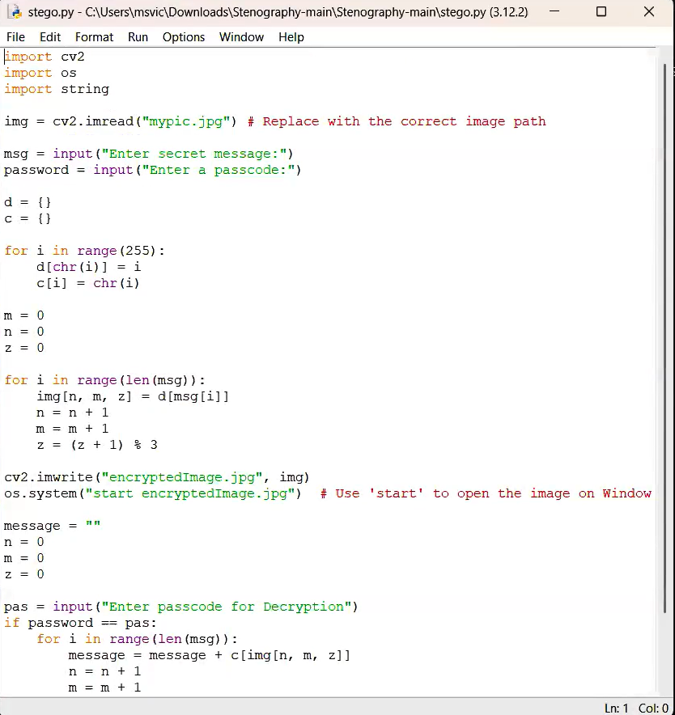
Results

Slide 8
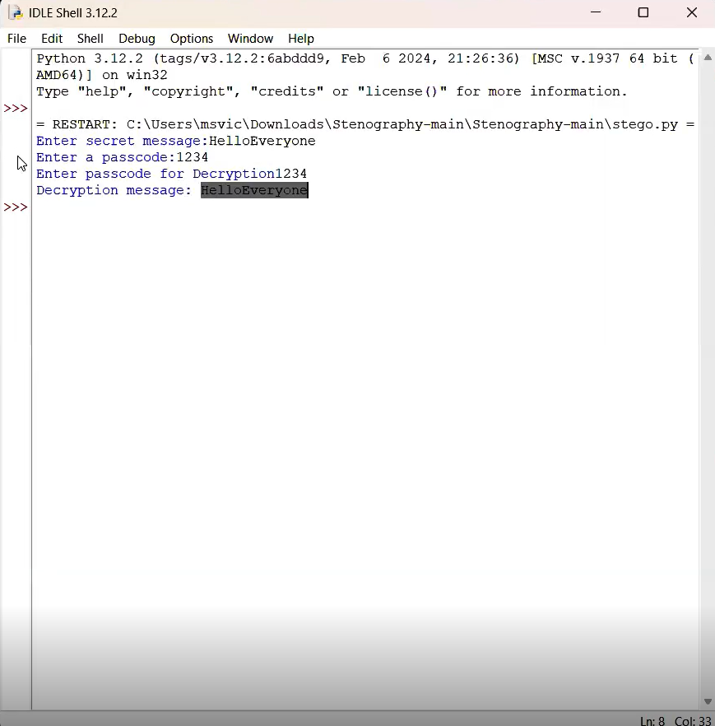
Results

Slide 9
Conclusion
Steganography is a powerful technique for secure data transmission.
This project demonstrates how to hide data within images using pixel manipulation.
The tool is simple, secure, and effective for basic steganography needs.
Future enhancements can include advanced encryption and support for larger messages.

Slide 10
GitHub Link
https://github.com/rahulraj578/Data-hiding

Slide 11
Future scope
Advanced Encryption: Implement AES or RSA encryption for added security.
LSB Steganography: Modify only the least significant bits of pixel values for better invisibility.
GUI Development: Create a user-friendly interface using tkinter or PyQt.
Support for Other Media: Extend the tool to hide data in audio and video files.
Machine Learning Integration: Use ML to detect and prevent steganalysis attacks.

Slide 12
THANK YOU

